Slide 2
THE MODERN CLOUD DATA WAREHOUSE
Snowflake on Azure

Slide 3






KOEN VERBEECK
SENIOR BUSINESS INTELLIGENCE CONSULTANT
SQLKOVER.COM
@Ko_Ver

Slide 4



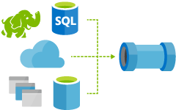


outline
Notes:
what is Snowflake?
Snowflake architecture
intro to time travel
typical load pattern
cool stuff
conclusion

Slide 5
what is Snowflake?

Slide 6

WARNING
MARKETING SLIDES

Slide 7

Founded 2012 by industry veterans
First customers 2014, general availability 2015
Over $450M in venture funding from leading investors
Over 1200 customers today
Notes:
Snowflake was founded in 2012 by a team of database experts and industry veterans from companies including Oracle, Teradata, Actian, and Cloudera.
We have significant backing from established investors who have a track record of success, ensuring that we have the resources to continue to invest in our product and growth.\
We’ve been adopted by a rapidly growing number of customers since customers first started using our product in 2014, and over 700 have signed up for Snowflake to date.

Slide 8
what companies need from a DWH
Focus on analytics
Support All Data
Scale On-Demand
Serve All of Your Users
Current technologies need constant attention, tuning, and tweaking for sub-optimal performance
Current technologies aren’t optimized for relational or non-relational data, leading to silos and data marts
Ad-hoc queries are difficult to support with fixed resources
Concurrency and contention lead to queues, long query times, and frustrated users
Notes:
You can focus more on actually developing your dwh model and getting data in, while worrying less about the technical stuff.

Slide 9
DWH built for the cloud
100% Cloud
Complete SQL Database
Zero Management
All of your Data
All of your Users
Pay only for what you use

Slide 10














Leverage the skills and tools you already have
Query
Complete SQL database
Data definition
Role based security
Updates and deletes
Multi-statement transactions
Support for the SQL that business users already know
Broad ecosystem of technology partners
z
Notes:
And Snowflake provides all this in a solution that works with the skills and tools you already have.
Unlike some of the much-hyped “big data” systems, Snowflake doesn’t require you to learn a new paradigm, train your team on a completely new technology, or deal with incomplete functionality that you expect from a data warehouse.
Snowflake built a solution that is a complete standard SQL database:
Our own survey of over 300 respondents indicated 80% of database users preferred SQL to query their database
Being a complete SQL database means Snowflake works the tools business users understand such as ETL and analytics tools
Fully ACID-compliant relational database that supports role-based security, multi-statement transactions and a host of other features

Slide 11
Focus on data, not infrastructure
Load data and run queries, Snowflake handles the rest
Zero work to deploy and manage infrastructure
ZERO OPTIONS
Management
Secure & highly available
Fully managed with no knobs or tuning
No indexes, distribution keys, partitioning or vacuuming
Notes:
Snowflake focused on building a solution that doesn’t consume you with tuning and management so that you can focus on your data and analytics.
All you need to do is load your data into Snowflake and run queries. We do everything else.
No optimization to do or backups to run.
No distribution keys, no partitioning to define and no vacuuming required.
Performs well across a broad spectrum of queries.
Great performance without having to constantly tweak the system.

Slide 12
All of your data
Structured and semi-structured data (JSON, XML, Avro, Parquet, ORC)
IoT
Centralized storage of data, accessible by any user & application
z
Enterprise apps
Web
Multi-petabyte scale
3rd party apps
Corporate
Query petabytes of data in as little as a few seconds
Mobile
Notes:
Store the information your business generates efficiently and cost-effectively in one place.
Put all of your business data, structured and semi-structured, in your cloud data warehouse.
Load petabytes of data since the volume of Snowflake is essentially unlimited.
Load semi-structured data and read it directly into the cloud data warehouse without any schema definition but treat it as if it were relational structured data.
Any business user with the appropriate security privileges can query the data.

Slide 13
All of your users
Up to 200x faster than solutions not built for the cloud
Maintains a consistent SLA – resources grow and shrink automatically
Loading data does not impact query performance
Multiple groups access data at the same time with no performance degradation
Supports an unlimited number of simultaneous users
Predictive analytics
Data exploration
Data-driven applications
BI/ Reporting
Diverse applications
Notes:
- A very different approach to running a very large number of users simultaneously.
- With compute truly separated from storage, Snowflake effectively allows an infinite number of compute clusters to operate on the same data at the same time.
Snowflake can load data into what we call a virtual data warehouse and run queries in one or more separate virtual warehouses.
And the loading of data has no impact on performance.

Slide 14
DEMO
Notes:
Quickly run some queries in the browser and introduce the workspace in the browser (account stuff etc)

Slide 15
architecture

Slide 16
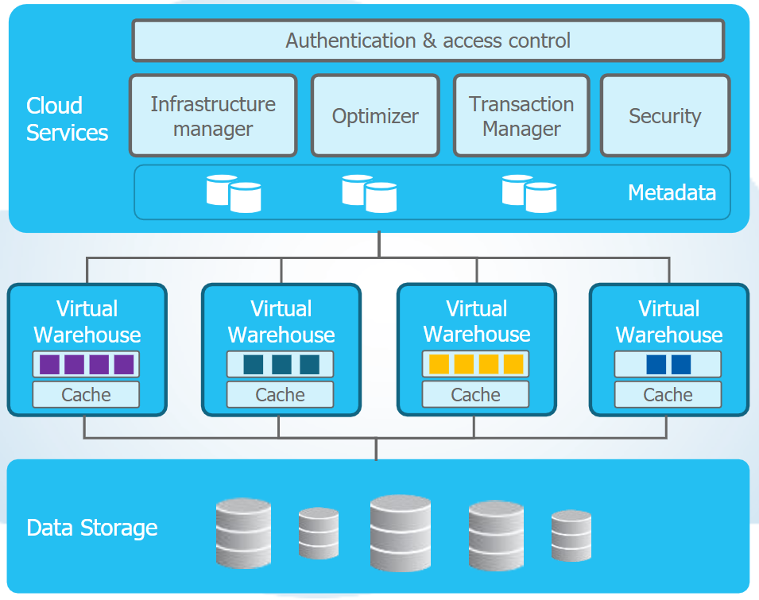
multi-cluster, shared data architecture
independent & stateless services
brain of the system
crucial data management activities
stores and versions all state in key-value store
elastic virtual warehouses
muscle of the system
parallel query processing
hybrid columnar

Slide 17

optimizer
top-down cost-based optimization
automatic statistic gathering
built-in join order optimization
no user input or tuning required
… or possible
supports most data models
3NF, star, snowflake, data vault
optimizations for star schema

Slide 18

metadata service
foundation for
optimized micro-partition pruning
time travel
zero-copy cloning
data sharing
linear scale
catalog definitions
users
sessions
access control
copy history
transactions
Metadata Processing
Compute Engine
Compute Engine
Compute Engine

Slide 19
metadata enables pruning
pruned partitions
2019-06-01
2019-06-02
2019-06-03
access only data that is needed
no traditional indexes are used
automatic pruning
metadata is used to decide which partitions are needed for a query
min/max values, #distinct values, #nulls
2019-06-04
2019-06-05
2019-06-06
2019-06-07
2019-06-08
2019-06-09
2019-06-10
2019-06-11
partitions
2019-06-12
2019-06-13

Slide 20

transactions & concurrency control
fully ACID
full SQL DML support
locking
queries read consistent snapshot without locks and never block
COPY and stand-alone INSERT do not block
UPDATE, DELETE and MERGE require partition file block
transaction support
one or multiple statements
BEGIN / COMMIT / ROLLBACK
AUTOCOMMIT parameter

Slide 21

transactions & concurrency control
fully ACID
table versioning
each DML produces a new “version” of the table
adds or removes entire file partitions
optimized for immutable cloud storage
based-on multi-version concurrency control
more on this later…

Slide 22

virtual warehouses

Slide 23
size XS

Slide 24
size S

Slide 25
size M

Slide 26
size L

Slide 27
size XL

Slide 28
size 2XL

Slide 29
size 3XL

Slide 30
size 4XL

Slide 31

virtual warehouse
compute engine of Snowflake
scale up or down as you need to
pay-per-usage
pause if not needed
auto-suspend and auto-resume (drops cache!)
can be scripted through SQL or other interfaces

Slide 32
multi-cluster warehouse
load-balance your user and query concurrency over multiple compute resources
up to 10
can be resized, suspended and resumed as well
auto-scale possible
economy mode available

Slide 33
warehouses
Marketing
Finance
ETL / ELT
Development

Slide 34

credit consumption
Size | 1 | 2 | 3 | 4 | 5 | 6 | 7 | 8 | 9 | 10
4XL | 128 |  |  |  |  |  |  | 1024 | 1152 | 1280
3LX | 64 |  |  |  |  |  | 448
2XL | 32 |  |  |  |  | 192
XL | 16 |  |  |  | 80
L | 8 |  |  | 32
M | 4 |  | 12
S | 2 | 4
XS | 1 | 2 | 3 | 4 | 5 | 6 | 7 | 8 | 9 | 10
credits per hour
price depends on licensing
Enterprise = $4 / credit (storage $25 - $40 / TB / month)

Slide 35
Snowflake editions and support offerings
Virtual Private Snowflake (VPS)
Enterprise for Sensitive Data +
Customer dedicated virtual servers wherever the encryption key is in memory
Customer dedicated metadata store
Secure proxy to customer VPC or on-premises datacenter
Business Critical Support
Enterprise For Sensitive Data
Enterprise +
HIPAA Support
PCI Compliance
Data encryption everywhere
Enhanced security policy
Customer managed encryption keys
Enterprise
Premier +
Multi-Cluster warehouse
Up to 90 days of time travel
Periodic rekey of all encrypted data
Audit log
Cross region replication
Premier
Standard +
Premier Support 24 x 365
Faster support response time
SLA with refund for outage
Standard
Complete SQL Data Warehouse
Business hour support M-F
1 day of time travel
Always-on enterprise grade encryption in transit and at rest
Federated authentication
Business Critical Support (BCS)
Named Technical Account Manager
Integration with customer operations
Query validation before upgrades
Architectural advice and consulting

Slide 36
DEMO
Notes:
Virtual warehouses: Run a query, scale up, run query again.

Slide 37
time travel

Slide 38


Slide 39
time travel
time travel SQL:
SELECT … AT/BEFORE …
CLONE … AT/BEFORE …
UNDROP …
standard SQL:
queries, DML, DDL …
no user operations allowed
current data storage
time travel retention (1 – 90 days)
fail-safe (transient: 0 days, permanent: 7 days)

Slide 40
time travel
SELECT * FROM myTable AT (timestamp => '2019-06-21 12:00:00'::timestamp);
SELECT * FROM myTable AT (offset => -60*5); -- 5 minutes back
SELECT * FROM myTable BEFORE (statement => '8e5d0ca9-005e-44e6-b858-a8f5b37c5726');
this is when you f**** up

Slide 41

undrop
UNDROP DATABASE / SCHEMA /TABLE
this is when you really f**** up

Slide 42

zero-copy cloning

Slide 43
zero-copy cloning
CREATE DATABASE myDB CLONE myOtherDB
(AT | BEFORE time travel stuff)
other objects as well
metadata-only operation
clone is write-able and independant of source

Slide 44
DEMO
Notes:
Show time travel, an undrop of a table and copying of an entire database.

Slide 45
loading data

Slide 46

“legacy”
Data Sources
BI / Analytics
ETL
EDW
Datamarts
Marketing
OLTP Databases
Enterprise Applications
Finance
Third-Party
Externals
Test/Dev
Web / Log Data
Data Science
Other
Data Lake
/ Hadoop

Slide 47
“modern”
ETL / ELT /
Streaming
Azure
Data Sources
BI / Analytics
EDW
Marketing
OLTP Databases
Power BI
Enterprise Applications
any BI tool
Finance
Third-Party
Azure Blob storage
data unload / sharing
Externals
cloning
Test/Dev
Web / Log Data
snowpipe & external tables
Data Science
Python API
Other

Slide 48
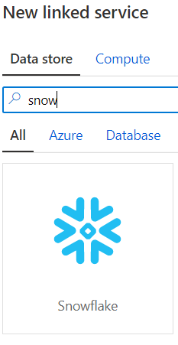


Azure Data Factory
Copy Activity

Slide 49

Azure Data Factory
COPY INTO

Slide 50
Azure Data Factory
Mapping DF

Slide 51
load from blob
COPY INTO myTable
FROM @stage/myfiles
FILE_FORMAT = (FORMAT_NAME = 'CSV_COMMA_HEADER_ENCLOSED')
PATTERN = '.*[.]gz'
PURGE = TRUE
ON_ERROR = 'SKIP_FILE';
Notes:
can detect if files have already been loaded
loads data in parallel
ideal file size between 10MB and 100MB compressed
supports CSV, JSON, AVRO, ORC, PARQUET and XML
limited SQL support to extract specific columns
can also be used to extract data from Snowflake into blob storage

Slide 52
load from blob
COPY INTO myTable
FROM @stage/myfiles
FILE_FORMAT = (FORMAT_NAME = 'CSV_COMMA_HEADER_ENCLOSED')
PATTERN = '.*[.]gz'
PURGE = TRUE
ON_ERROR = 'SKIP_FILE';
Notes:
can detect if files have already been loaded
loads data in parallel
ideal file size between 10MB and 100MB compressed
supports CSV, JSON, AVRO, ORC, PARQUET and XML
limited SQL support to extract specific columns
can also be used to extract data from Snowflake into blob storage

Slide 53
load from blob
COPY INTO myTable
FROM @stage/myfiles
FILE_FORMAT = (FORMAT_NAME = 'CSV_COMMA_HEADER_ENCLOSED')
PATTERN = '.*[.]gz'
PURGE = TRUE
ON_ERROR = 'SKIP_FILE';
Notes:
can detect if files have already been loaded
loads data in parallel
ideal file size between 10MB and 100MB compressed
supports CSV, JSON, AVRO, ORC, PARQUET and XML
limited SQL support to extract specific columns
can also be used to extract data from Snowflake into blob storage

Slide 54
load from blob
COPY INTO myTable
FROM @stage/myfiles
FILE_FORMAT = (FORMAT_NAME = 'CSV_COMMA_HEADER_ENCLOSED')
PATTERN = '.*[.]gz'
PURGE = TRUE
ON_ERROR = 'SKIP_FILE';
Notes:
can detect if files have already been loaded
loads data in parallel
ideal file size between 10MB and 100MB compressed
supports CSV, JSON, AVRO, ORC, PARQUET and XML
limited SQL support to extract specific columns
can also be used to extract data from Snowflake into blob storage

Slide 55
load from blob
COPY INTO myTable
FROM @stage/myfiles
FILE_FORMAT = (FORMAT_NAME = 'CSV_COMMA_HEADER_ENCLOSED')
PATTERN = '.*[.]gz'
PURGE = TRUE
ON_ERROR = 'SKIP_FILE';
Notes:
can detect if files have already been loaded
loads data in parallel
ideal file size between 10MB and 100MB compressed
supports CSV, JSON, AVRO, ORC, PARQUET and XML
limited SQL support to extract specific columns
can also be used to extract data from Snowflake into blob storage

Slide 56
load from blob
COPY INTO myTable
FROM @stage/myfiles
FILE_FORMAT = (FORMAT_NAME = 'CSV_COMMA_HEADER_ENCLOSED')
PATTERN = '.*[.]gz'
PURGE = TRUE
ON_ERROR = 'SKIP_FILE';
Notes:
can detect if files have already been loaded
loads data in parallel
ideal file size between 10MB and 100MB compressed
supports CSV, JSON, AVRO, ORC, PARQUET and XML
limited SQL support to extract specific columns
can also be used to extract data from Snowflake into blob storage

Slide 57
copy into
can detect if files have already been loaded
loads data in parallel
ideal file size between 10MB and 100MB compressed
supports CSV, JSON, AVRO, ORC, PARQUET and XML
limited SQL support to extract specific columns
can also be used to extract data from Snowflake into blob storage

Slide 58



Azure Data Factory
self-hosted IR
with OCDB
ADF
Snowflake
cloud
cloud
on-premises

Slide 59

Azure Data Factory
Azure Function
ADF
Snowflake
cloud

Slide 60
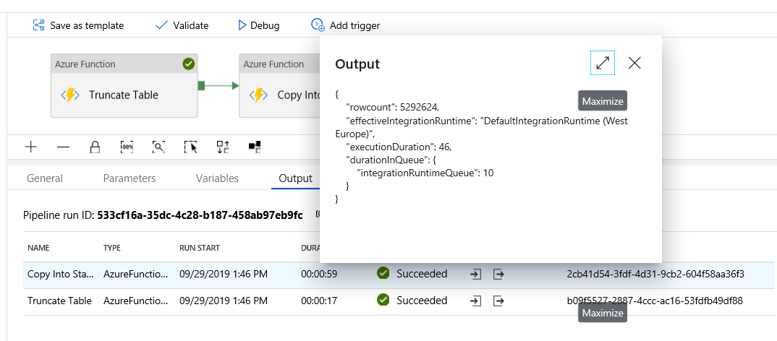
Azure Data Factory

Slide 61
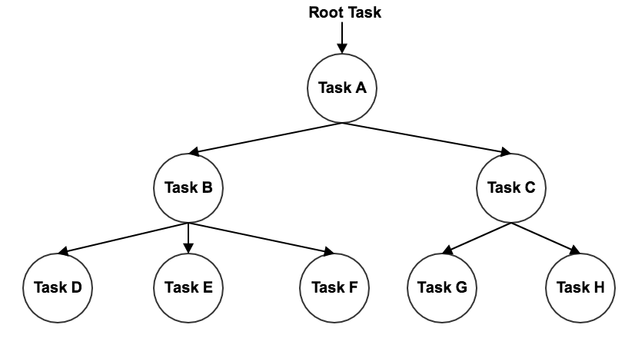
tasks and streams
courtesy: https://docs.snowflake.net/manuals/user-guide/tasks-intro.html

Slide 62
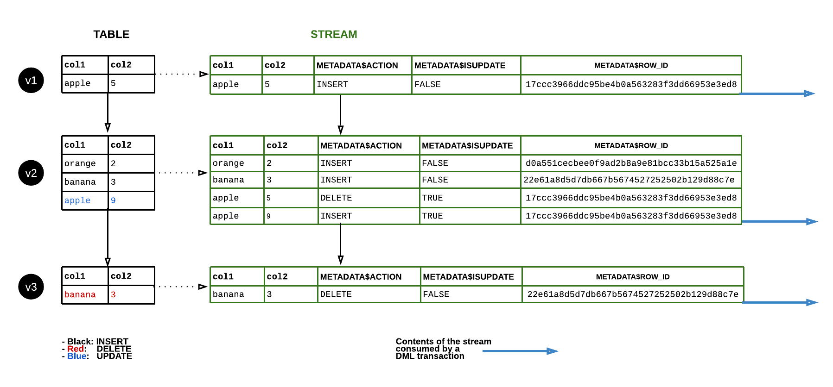
tasks and streams
courtesy: https://docs.snowflake.net/manuals/user-guide/streams.html

Slide 63
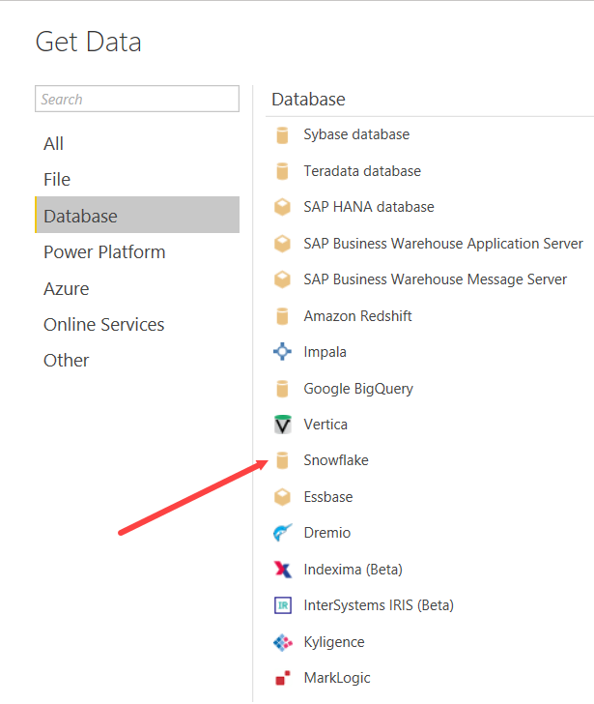
Power BI

Slide 64
DEMO
Notes:
show copy into and parsing of XML files of StackOverflow

Slide 65
cool stuff

Slide 66

cool stuff already covered

Slide 67
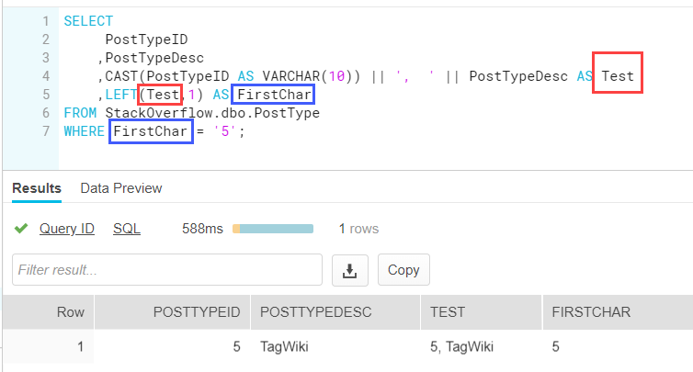
aliasing all the things

Slide 68
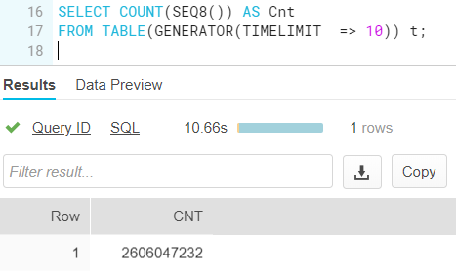
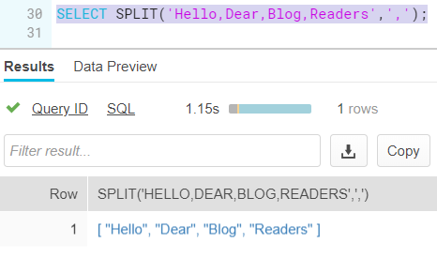
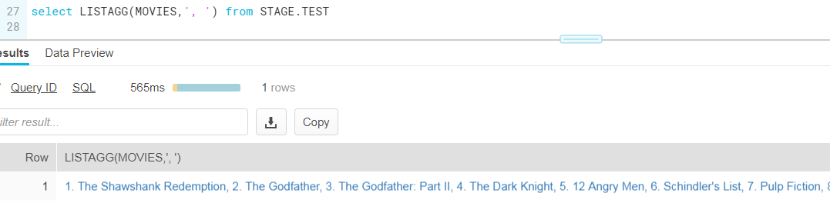
great SQL functionality

Slide 69
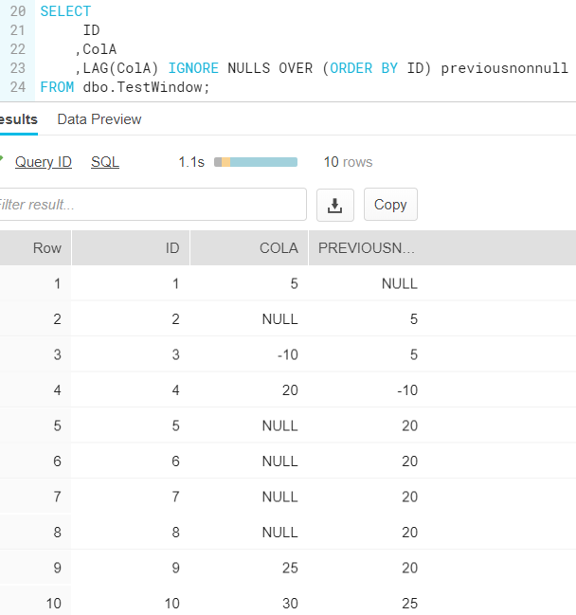

Slide 70
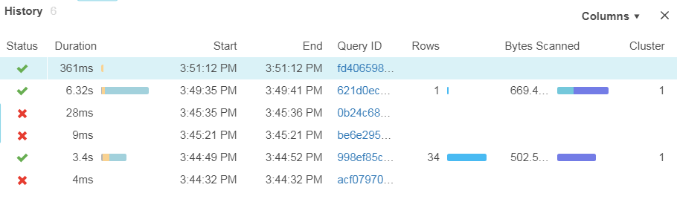
query history (and result set cache)

Slide 71
DEMO
Notes:
show query history and get_ddl()

Slide 72
conclusion

Slide 73
snowflake vs traditional DWH
Traditional databases are inflexible
Snowflake uses the cloud
to enable elasticity
Usage
varies
Pay only for what you use with no overprovisioning
Eliminate
overbuy
Scale compute up and down, transparently and automatically
No need for capacity planning, make capacity decisions on the fly

Slide 74


Slide 75


Slide 76


Slide 77


Slide 78
some disadvantages
still a young product
community has to grow
a few bugs here and there
less tools available
e.g. no schema compare (but vendors are catching up!)
almost no tuning options
sometimes plans stumble and spill to disk
role management is hard
keep an eye on cost

Slide 79
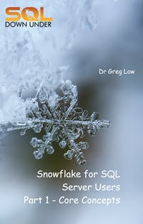
more resources
https://sqldownunder.com/f/snowflakeforsqlserverusersebook

